Slide 1
Chapter 2 Section 2
English colonies in America

Slide 2
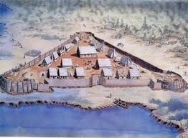
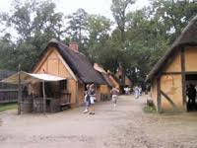
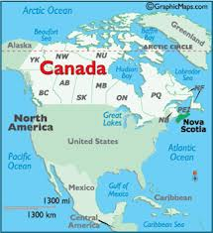
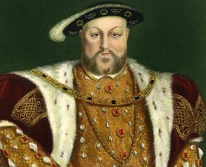
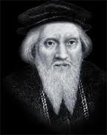
Jamestown = the first successful English colony in the New World
John Cabot =King Henry VIII sent him to explore= Nova Scotia
Newfoundland

Slide 3
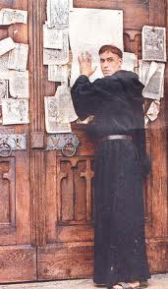
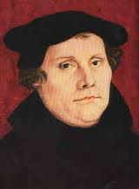
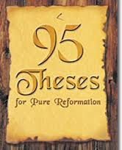
While others were exploring, Martin Luther a German monk was writing
95 thesis as to what was wrong with the Catholic Church
He started the Protestant Reformation
Protestant reformation = protested and wanted to reform the Catholic Church

Slide 4
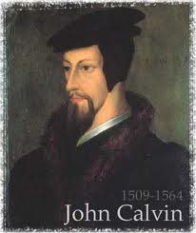
John Calvin=People in the church should select their ministers not the king or Pope
This is the beginning of FREEDOM OF RELIGION

Slide 5
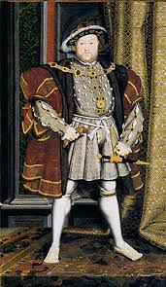
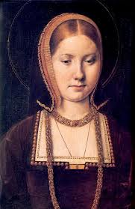
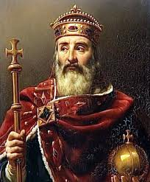
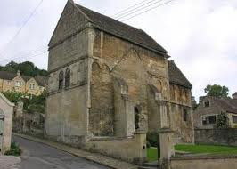
King Henry VIII (England) wants a divorce. He asks the Pope to grant him one. The king is married to Catherine whose uncle was the King of Spain
If he grants it, it could mean war between Spain and England
King Henry VIII will start his own church=The Church of England or Anglican Church

Slide 6
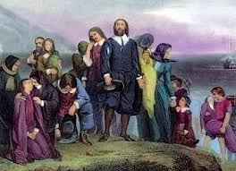
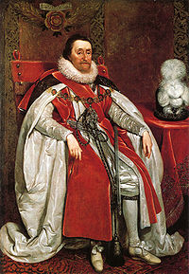
Puritans=left England=purify church
James I= new king of England & Protestant =“if you don’t like it=leave”
Puritans leave and become SEPARATISTS
When they return they will be called PILGRIMS

Slide 7
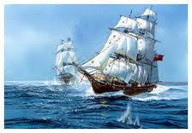
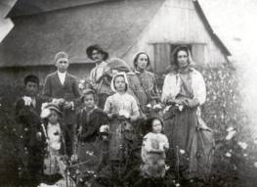
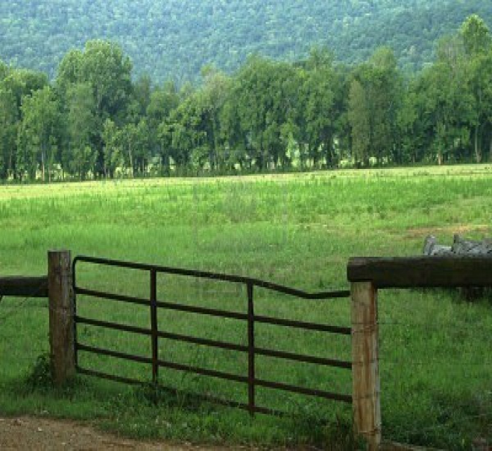
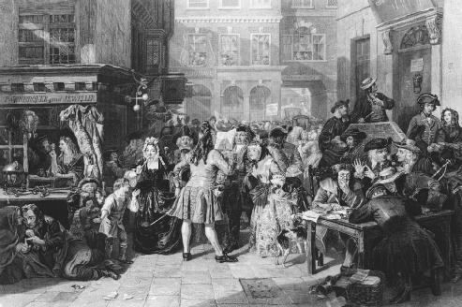
Tenant farmers=rented land for farming=told to leave so owners could raise sheep
Owners ENCLOSED (fenced in) land
People formed companies=joint-stock companies & bought ships to come to New
World
Privateers=privately owned ships

Slide 8
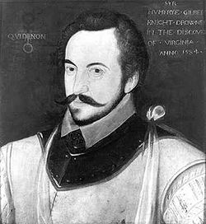
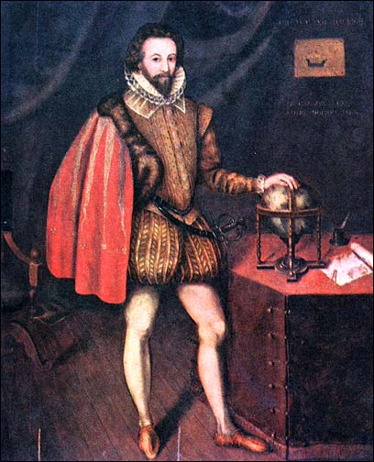
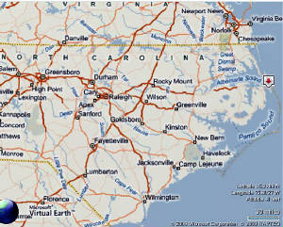
Sir Humphrey Gilbert=charter=permission to explore and claim land= Drowns
Sir Walter Raleigh=explores Roanoke=Lost Colony
Roanoke=CRO=Croatoans

Slide 9
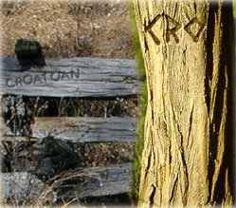
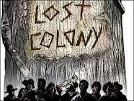
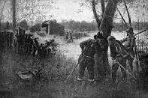
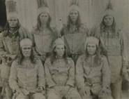

Slide 10
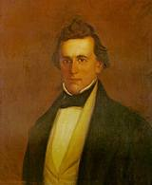
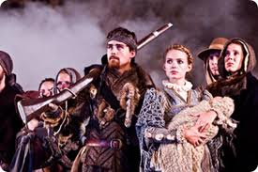
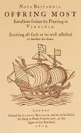
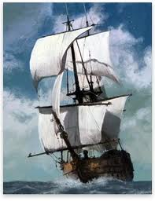
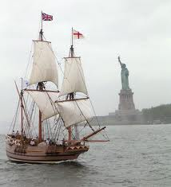
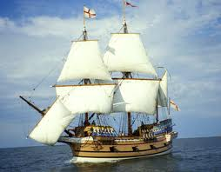
John White=governor of Roanoke=Virginia Dare (first English child born in New World)
Virginia Company=Jamestown= Godspeed, Susan Constant, Discovery

Slide 11
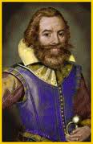
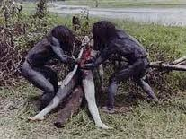
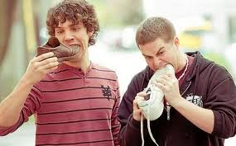
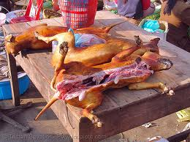
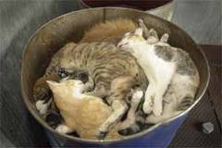
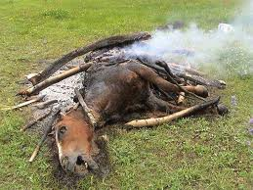
John Smith=leader of Jamestown=“you don’t work, you don’t eat’
Starving time= people went through =ate dogs, cats, horses, tree bark, roots, people, shoes

Slide 12
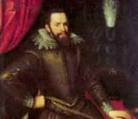
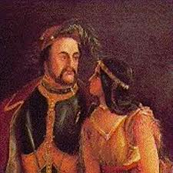
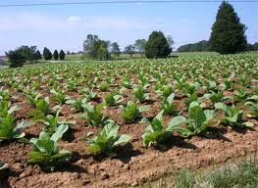
Thomas Dale=Jamestown survives=private cultivation=plant your garden, donate 1 month
of corn to colony
John Rolfe=tobacco=first successful cash crop, married Pocahontas

Slide 13
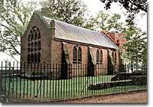
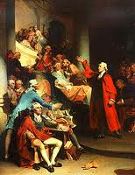
House of Burgesses=first elected assembly of Virginia
This was the first time the colonists had the right to VOTE and ELECT their
officials

Slide 14
To get more people to come to the New World they started the
Headright System=get 50 acres of land for every person you bring to New World
Royal Colony=run by king/queen
Lord Baltimore=est. Maryland for Catholics
Proprietary Colony=run by a person
Company Colony=run by a company of investors
Pocahontas=princess of Powhatan tribe, married John Rolfe
Compass rose=cardinal directions

