Slide 1
Hernan Cortes
Conquering the Aztecs
1. Smallpox killed laborers (slaves=Indians) in Cuba
2. Cortez sent to Yucatan Peninsula to get more
3. Spanish soldiers (conquistadors) fight Indians and advantages are:
a. weapons b. soldiers in armor c. interpreter d. allies e. disease f. horses g. god
4. Quetzalcoatl=former god of Aztecs
5. Montezuma= leader of Aztec=sacrifice=blood given to Cortes
6. Tenochtitlan=capital of Aztec=center of city =tzompantli=human skulls
7. Cortes orders all statues of Aztecs to be replaced by Virgin Mary and Christian crosses
8. Battle between Cortes and Montzemuma=Montezuma dead=4,000 Aztecs dead and 450 Spainiards=Sad Night or Noche trist
9. Smallpox breaks out and kills millions of Aztecs

Slide 2
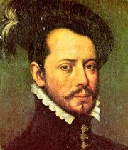

Slide 3
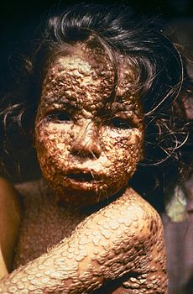

Slide 4
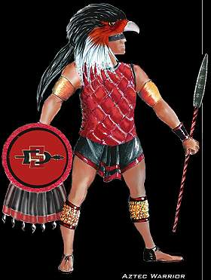

Slide 5
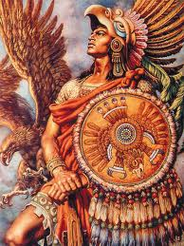

Slide 6
New Spain E X P A N D S
1. Tenochtitlan rebuilt and now Mexico
2. All territory Spain claims will be called New Spain
3. Incas conquered by Pizzaro=he takes ruler (Atahualpa ) captive and kills him (Atahualpa offered a bible and throws it to the ground)
4. Panfilo Narvaez=looking for city of gold (Seven cities of Cibola)=fable=find TX
5. Francisco Coronado=shaggy cows= buffalo
6. Hernan de Soto= explored Southeast=DeSoto Caverns= buried in mouth of Mississippi
7. Spanish give northern territory new name=New Mexico and capital was Sante Fe
8. Catholic Church began colonizing area to convert Indians
9. Missions were built and were linked by El Camino Real or Royal highway
10. Some priests beat Indians who disobeyed or cut off noses
11. Pope’ leads a rebellion against Spaniards

Slide 7
Spanish American Society
1. Conquistadors= hidalgos=low ranking nobles=Spanish soldiers=conquer Indians
2. Cortes rewards men with villages under the encomienda system= (1) Indians work and find gold or pay gold
(2) Protect and Christianize=Spanish part
3. Spain’s Social class= (1) Peninsulares , born in Spain (2) Criollos, born in New Spain (3) Mextizo, born in New Spain of
Spanish and Indian parents
4. King can’t govern from overseas= Council of Indies=advise king=divide land= viceroy
5. Indians used as slaves in silver mines
6. food would not grow=cattle=huge ranches=haciendas= vaqueros

Slide 9
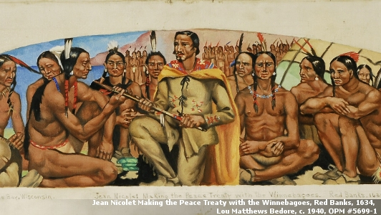
The French Empire in America
1. King Francis I= Northwest Passage=waterway across America=NOT
2. Jacquis Cartier=St. Lawrence River
3. All lands claimed by France= New France
4. Samuel de Champlain=Quebec= capital of New France
5. Economy=beaver fur and deer
6. No settlers needed= coureurs de bois=runners of the woods

Slide 11
New France E X P A N D S
1. King Louis XIV makes New France a royal colony
2. To help populate=Sent 900 women over to colony=under 16 (woman), man under 20=royal gift, parents with 10 children = $
3. Louis Joliet and Jacques= Mississippi River down to Arkansas River
4. Rene” La Salle=followed Mississippi down to gulf=claimed for King Louis=Louisiana
5. France will settle Mobile and New Orleans= planatations=slaves
6. France will settle St. Augustine=first permanent town established by Europeans

Slide 12
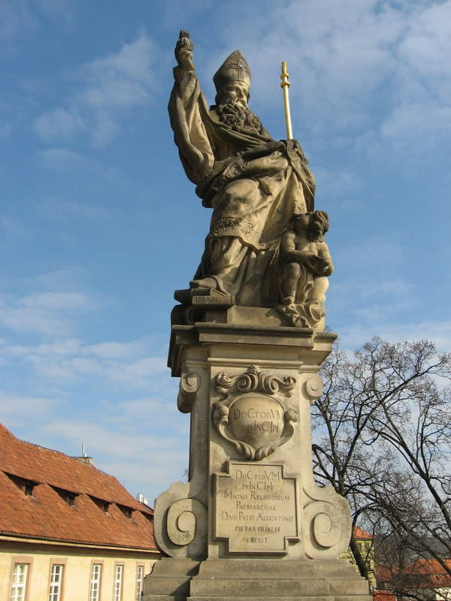

Slide 13
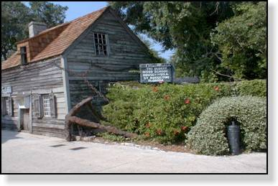

Slide 14
